Slide 1

An Introduction to Bandit Algorithm
Qing Wang, Ph. D. student, 2016
Some slides from Li Zhou and Jure Leskovec

Slide 2


AGENDA
Motivation
Background
Contextual-free MAB
Contextual MAB
Results and Future work
Question

Slide 3

What is news personalization?
Customize news feed based on users’ interests.
Particularly, Cold Start problem: How to personalize news for a new user?
Goal: Maximize user engagement

Slide 4
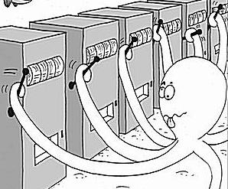
Multi-armed Bandit Algorithm
A gambler →casino
A row of slot machines providing a random rewards
Objective: Maximize the sum of rewards(Money)!

Slide 5

Multi-armed Bandit
Take news personalization as an example
There are a bunch of articles in the news pool
Users come sequentially and ready to be enter
News articles

Slide 6
Multi-armed Bandit
At each time, we want to select one article for a user
article 1
news articles
Like it?

Slide 7

Multi-armed Bandit
Goal: maximize CRT(click through rate)
Not really!
article 1
news articles
Like it?

Slide 8
Multi-armed Bandit
Update the model with user’s feedback
Not really!
article 1
news articles
feedback
Like it?

Slide 9
Multi-armed Bandit
Update the model with user’s feedback
Not really!
article 1
news articles
feedback
Like it?

Slide 10
Multi-armed Bandit
Update the model once the user gives the feedback
Yeah!
article 2
news articles
Like it?

Slide 11

Multi-armed Bandit
Update the model once the user gives the feedback
Yeah!
article 2
news articles
feedback
Like it?
How about article 3,4,5…?

Slide 12


Slide 13
Multi-armed Bandit Definition
The MAB problem is a classical paradigm in Machine Learning in which an online algorithm choses from a set of strategies in a sequence of trials so as to maximize the total payoff of the chosen strategies[1].
[1] http://research.microsoft.com/en-us/projects/bandits/

Slide 14
Other Application
Clinical trials:
Investigate effects of different treatments while minimizing patient losses
Adaptive routing:
Minimize delay in the network by investigating different routes
Asset pricing:
Figure out product prices while trying to make optimal profit

Slide 15
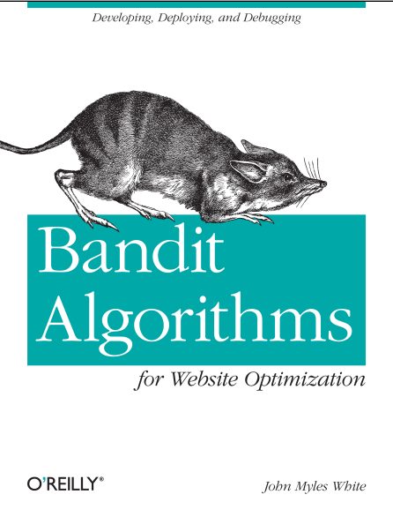
Some Jargon Terms
Arm: one idea/strategy
Bandit: A group of ideas(strategies)
Pull/Play/Trial: One chance to try your strategy
Reward: The unit of success we measure after each pull
Regret: Performance Metric
[1] Bandit Algorithms for Website Optimization Developing, Deploying, and Debugging By John Myles White, O'Reilly Media,2012

Slide 16
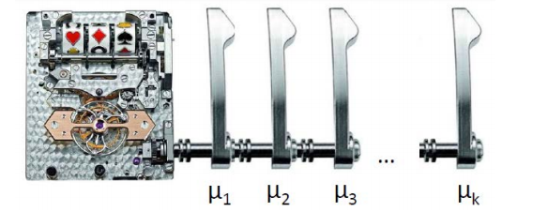
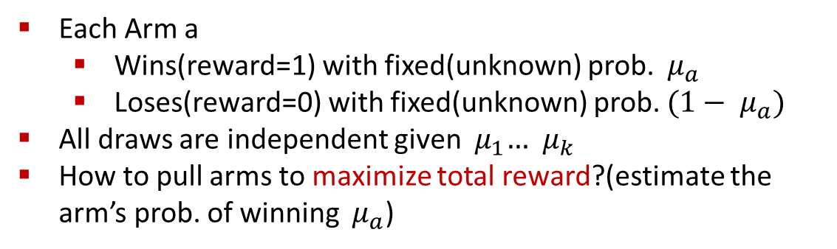
K-Armed Bandit
Each Arm a
Wins(reward=1) with fixed(unknown) prob. ${ μ}_{a}$
Loses(reward=0) with fixed(unknown) prob. ${(1− μ}_{a})$
All draws are independent given ${ μ}_{1}… { μ}_{k}$
How to pull arms to maximize total reward?(estimate the arm’s prob. of winning ${ μ}_{a}$)

Slide 17
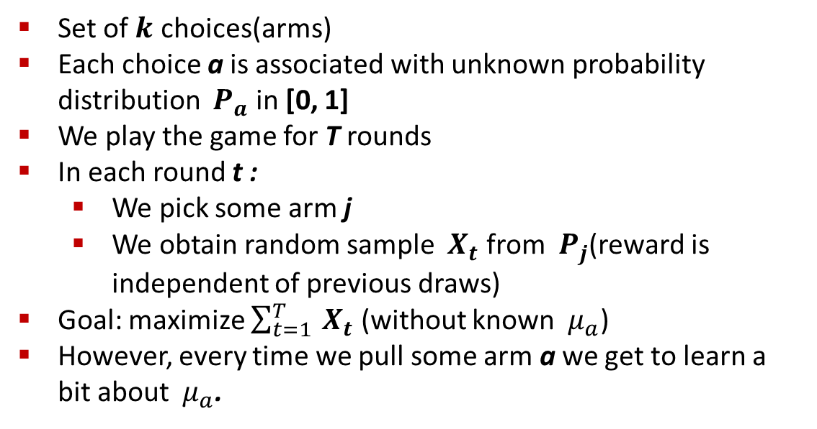
Model of Stochastic K-Armed Bandit
Set of $k$ choices(arms)
Each choice a is associated with unknown probability distribution ${ P}_{a}$ in [0, 1]
We play the game for T rounds
In each round t :
We pick some arm j
We obtain random sample ${ X}_{t}$ from ${ P}_{j}$(reward is independent of previous draws)
Goal: maximize $\sum_{t=1}^{T}{{ X}_{t}}$ (without known ${ μ}_{a}$)
However, every time we pull some arm a we get to learn a bit about ${ μ}_{a}$.

Slide 18
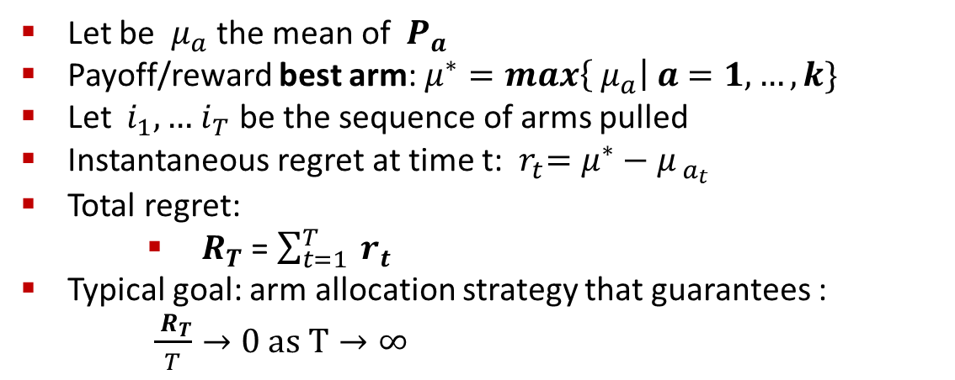
Performance Metric: Regret
Let be ${ μ}_{a}$ the mean of ${ P}_{a}$
Payoff/reward best arm: $μ^{∗}=max\left\{{ μ}_{a}\right| a=1, …,k\}$
Let ${ i}_{1}, …{ i}_{T}$ be the sequence of arms pulled
Instantaneous regret at time t: ${ r}_{t}=μ^{∗}−{ μ}_{{ a}_{t}}$
Total regret:
${ R}_{T}$ = $\sum_{t=1}^{T}{{ r}_{t}}$
Typical goal: arm allocation strategy that guarantees :
$\frac{{ R}_{T}}{T}→0 as T→∞$

Slide 19
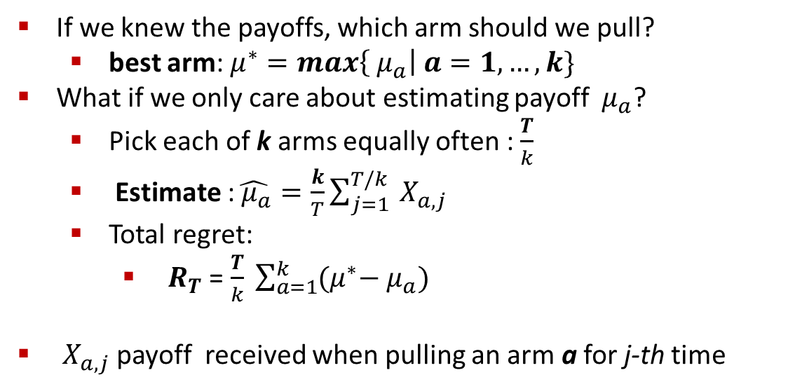
Allocation Strategies
If we knew the payoffs, which arm should we pull?
best arm: $μ^{∗}=max\left\{{ μ}_{a}\right| a=1, …,k\}$
What if we only care about estimating payoff ${ μ}_{a}$?
Pick each of k arms equally often : $\frac{T}{k}$
Estimate :$\hat{{ μ}_{a}}=\frac{k}{T}\sum_{j=1}^{T/k}{{ X}_{a,j}}$
Total regret:
${ R}_{T}$ = $\frac{T}{k} \sum_{a=1}^{k}{(μ^{∗}−{ μ}_{a}) }$
${ X}_{a,j}$ payoff received when pulling an arm a for j-th time

Slide 20
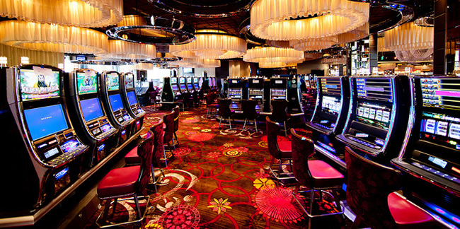
Exploration vs. Exploitation
Trade off between exploration (gathering data about arm payoffs) and exploitation (making decisions based on history data) in decision making.

Slide 21
Algorithm to Exploration & Exploitation
Exploration
Tradeoff
Exploitation
K bandit algorithm
Contextual free
Contextual
Epsilon algorithm
UCB1
Ex3, Ex4
Tompson Sampling
LinUCB

Slide 22
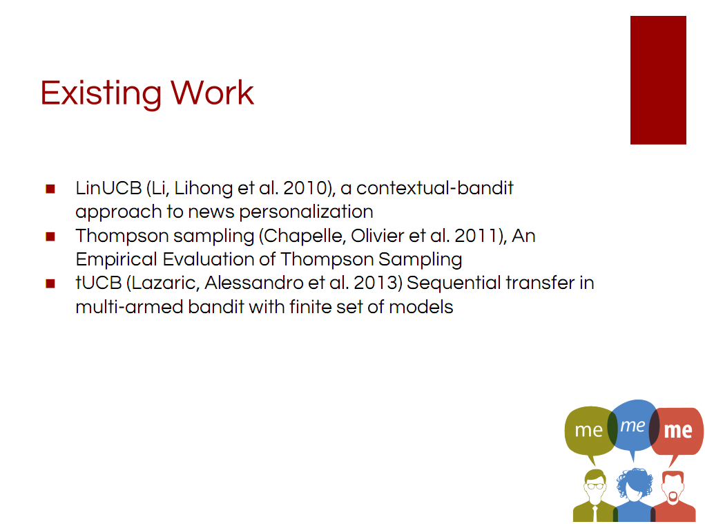

Slide 23
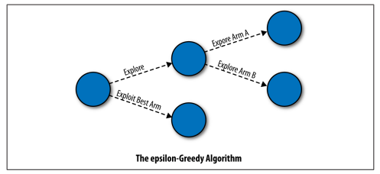

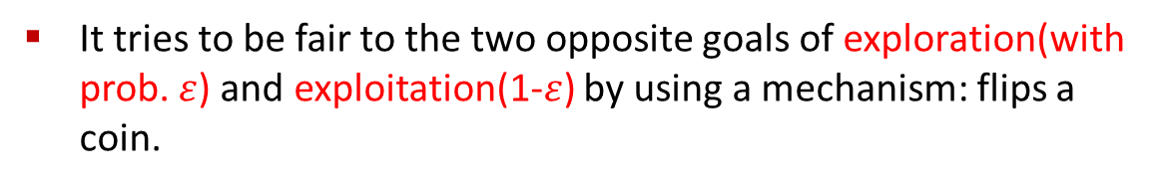
$ε$-Greedy Algorithm
It tries to be fair to the two opposite goals of exploration(with prob. $ε$) and exploitation(1-$ε$) by using a mechanism: flips a coin.

Slide 24

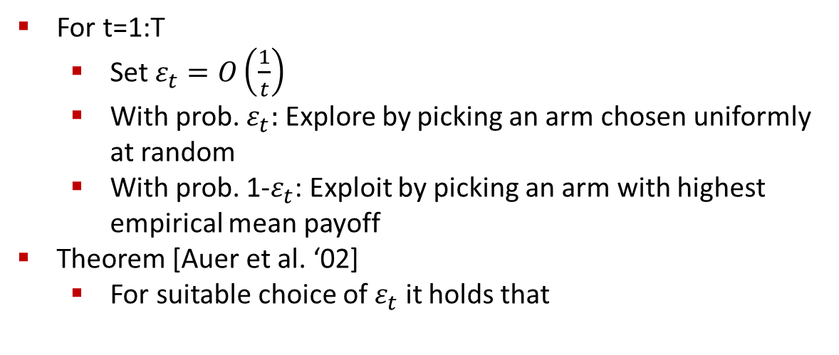
$ε$-Greedy Algorithm
For t=1:T
Set $ε_{t}=O\left(\frac{1}{t}\right)$
With prob. $ε_{t}:$ Explore by picking an arm chosen uniformly at random
With prob. 1-$ε_{t}$: Exploit by picking an arm with highest empirical mean payoff
Theorem [Auer et al. ‘02]
For suitable choice of $ε_{t}$ it holds that

Slide 25

Issues with $ε$-Greedy Algorithm
“Not elegant” : Algorithm explicitly distinguishes between exploration and exploitation
More importantly: Exploration makes suboptimal choices(since it picks any arm equally likely)
Idea: When exploring/exploiting we need to compare arms.

Slide 26
Example : Comparing Arms
Suppose we have done experiments :
Arm 1: 1 0 0 1 1 1 0 0 0 1
Arm 2: 1
Arm 3: 1 1 0 1 0 0 1 1 1 1
Mean arm values:
Arm 1: 5/10 Arm 2: 1 Arm 3: 7/10
Which arm would you choose next?
Idea: Not only look at the mean but also the confidence!

Slide 27
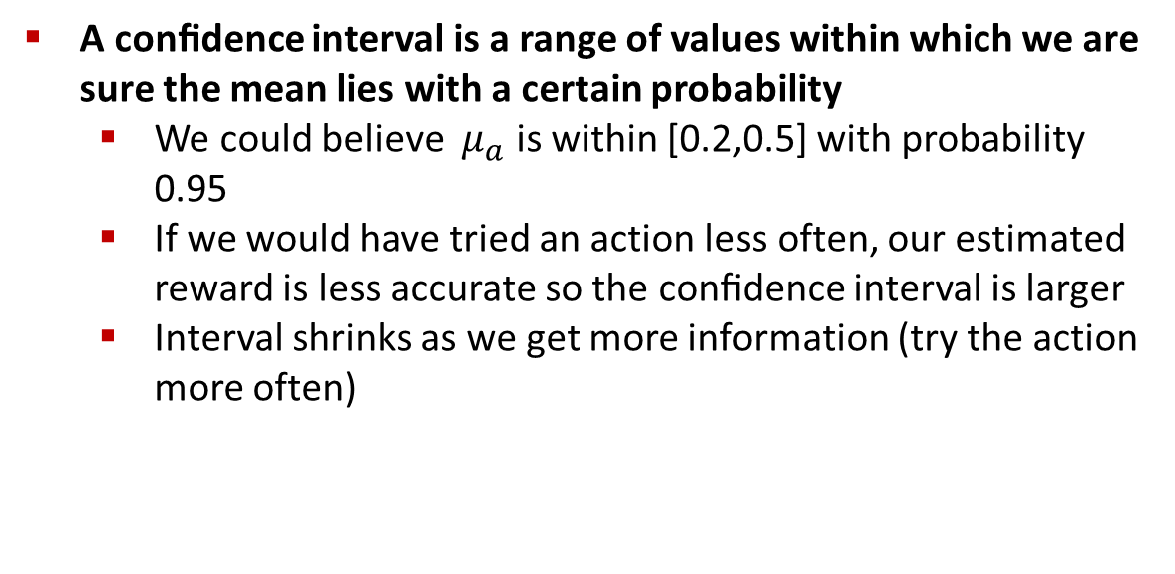
Confidence Intervals
A conﬁdence interval is a range of values within which we are sure the mean lies with a certain probability
We could believe ${ μ}_{a}$ is within [0.2,0.5] with probability 0.95
If we would have tried an action less often, our estimated reward is less accurate so the conﬁdence interval is larger
Interval shrinks as we get more information (try the action more often)

Slide 28
Confidence Intervals
Assuming we know the confidence intervals
Then, instead of trying the action with the highest mean we can try the action with the highest upper bound on its confidence interval.

Slide 29
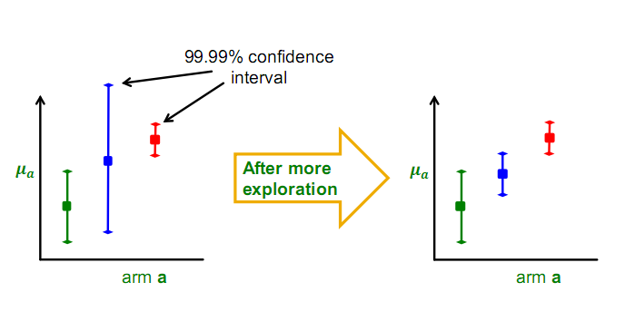
Confidence Based Selection

Slide 30
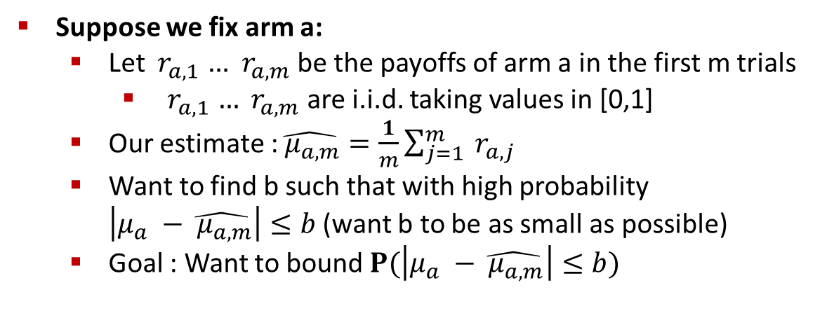
Calculating Confidence Bounds
Suppose we fix arm a:
Let ${ r}_{a,1} …$ ${ r}_{a,m}$ be the payoffs of arm a in the first m trials
${ r}_{a,1} …$ ${ r}_{a,m}$ are i.i.d. taking values in [0,1]
Our estimate :$\hat{{ μ}_{a,m}}=\frac{1}{m}\sum_{j=1}^{m}{{ r}_{a,j}}$
Want to find b such that with high probability $\left|μ_{a} −\hat{{ μ}_{a,m}}\right|≤b$ (want b to be as small as possible)
Goal : Want to bound $P(\left|μ_{a} −\hat{{ μ}_{a,m}}\right|≤b)$

Slide 31
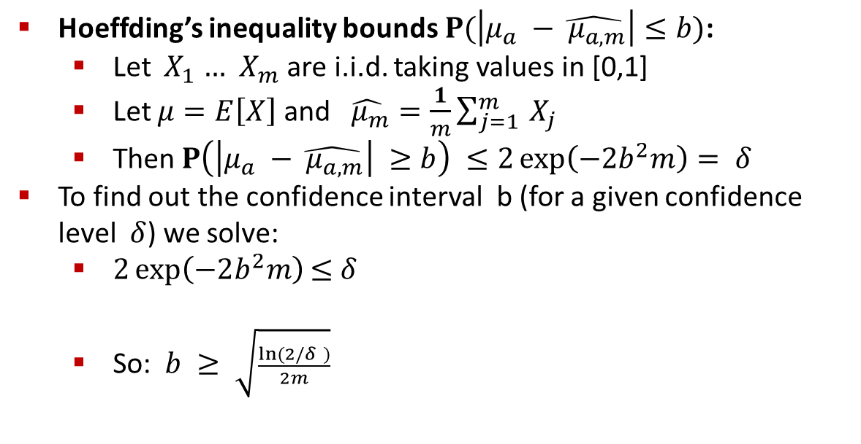
Hoeffding’s Inequality
Hoeffding’s inequality bounds$P(\left|μ_{a} −\hat{{ μ}_{a,m}}\right|≤b)$:
Let ${ X}_{1} …$ ${ X}_{m}$ are i.i.d. taking values in [0,1]
Let $μ=E\left[X\right]$ and $\hat{{ μ}_{m}}=\frac{1}{m}\sum_{j=1}^{m}{{ X}_{j}}$
Then $P\left(\left|μ_{a} −\hat{{ μ}_{a,m}}\right| ≥b\right) ≤2\exp\left(−2b^{2}m\right)= δ$
To find out the confidence interval b (for a given confidence level $δ$) we solve:
$2\exp\left(−2b^{2}m\right)$ $≤$ $δ$
So: $b ≥ \sqrt{\frac{ln⁡(2/δ )}{2m}}$

Slide 32
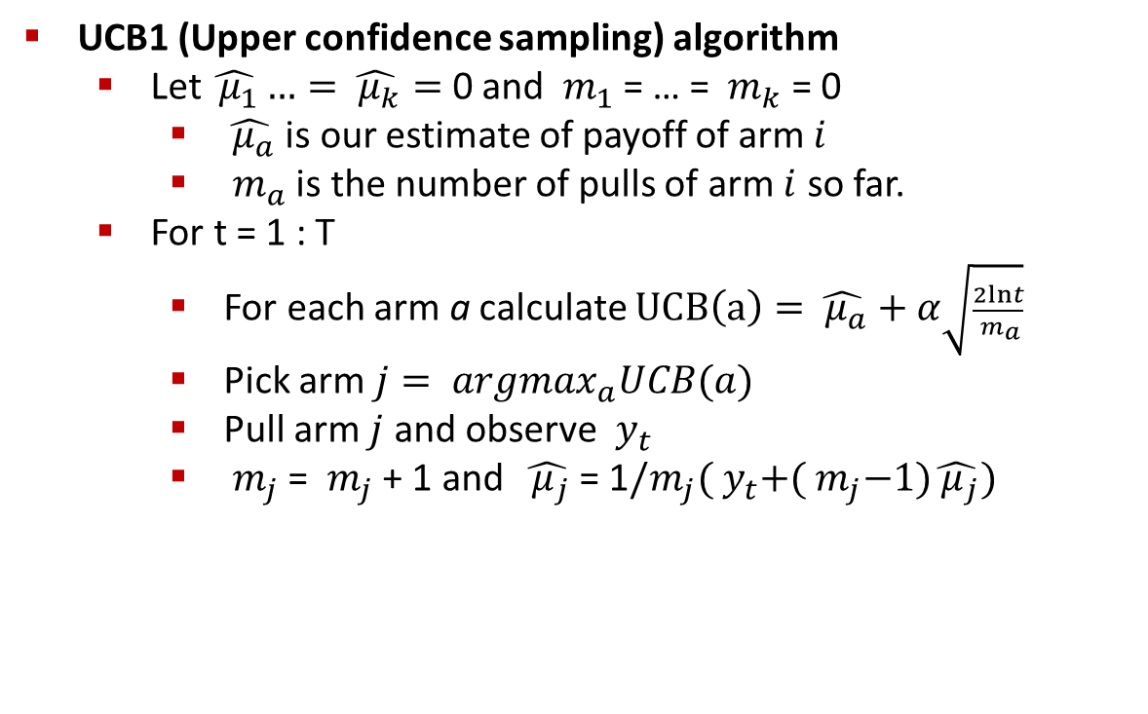
UCB1 Algorithm
UCB1 (Upper confidence sampling) algorithm
Let $\hat{{ μ}_{1}}…=\hat{{ μ}_{k}}=$ 0 and ${ m}_{1}$ = … = ${ m}_{k}$ = 0
$\hat{{ μ}_{a}}$ is our estimate of payoff of arm $i$
${ m}_{a}$ is the number of pulls of arm $i$ so far.
For t = 1 : T
For each arm a calculate $UCB\left(a\right)=\hat{{ μ}_{a}}+α\sqrt{\frac{2lnt}{{ m}_{a}}}$
Pick arm $j= {argmax}_{a}UCB(a)$
Pull arm $j$ and observe ${ y}_{t}$
${ m}_{j}$ = ${ m}_{j}$ + 1 and $\hat{{ μ}_{j}}$ = 1$/m_{j}({ y}_{t}+({ m}_{j}−1)\hat{{ μ}_{j}})$

Slide 33
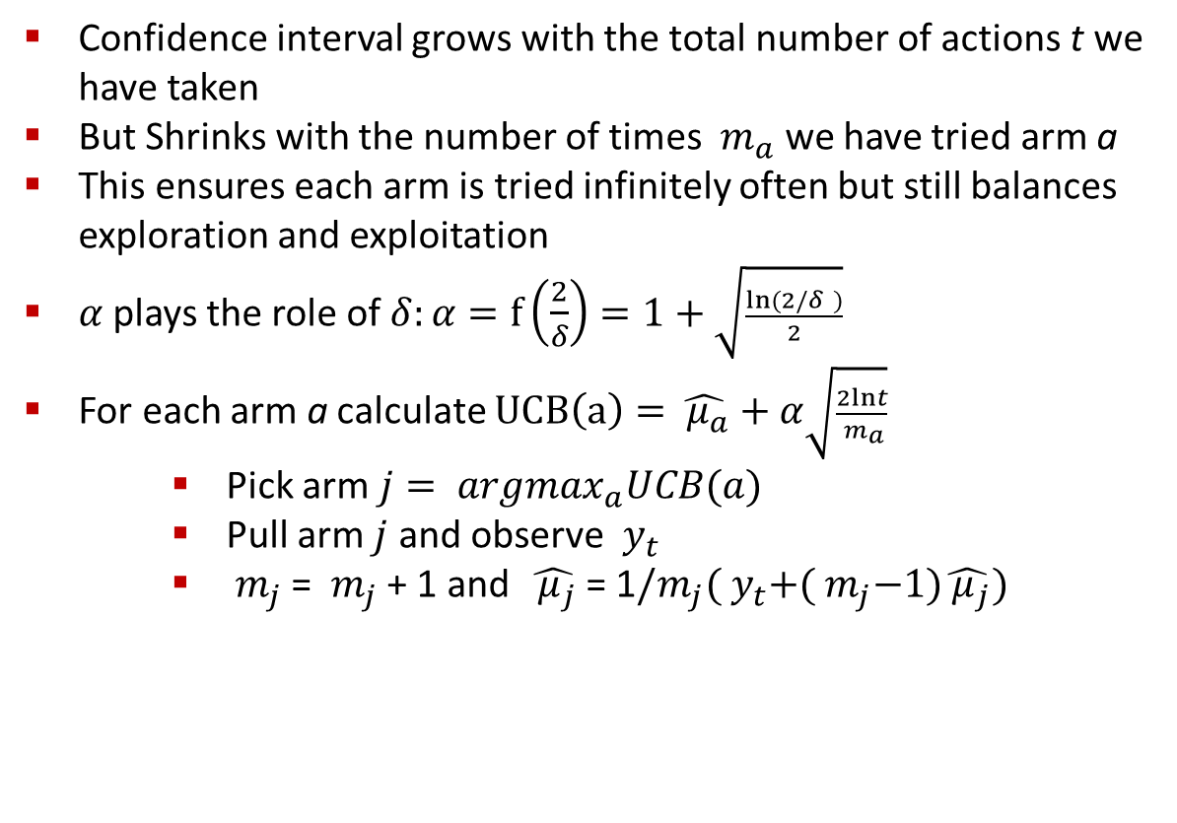
UCB1 Algorithm: Discussion
Confidence interval grows with the total number of actions t we have taken
But Shrinks with the number of times ${ m}_{a}$ we have tried arm a
This ensures each arm is tried infinitely often but still balances exploration and exploitation
$α$ plays the role of $δ:α=f\left(\frac{2}{δ}\right)=1+\sqrt{\frac{ln⁡(2/δ )}{2}}$
For each arm a calculate $UCB\left(a\right)=\hat{{ μ}_{a}}+α\sqrt{\frac{2lnt}{{ m}_{a}}}$
Pick arm $j= {argmax}_{a}UCB(a)$
Pull arm $j$ and observe ${ y}_{t}$
${ m}_{j}$ = ${ m}_{j}$ + 1 and $\hat{{ μ}_{j}}$ = 1$/m_{j}({ y}_{t}+({ m}_{j}−1)\hat{{ μ}_{j}})$

Slide 34


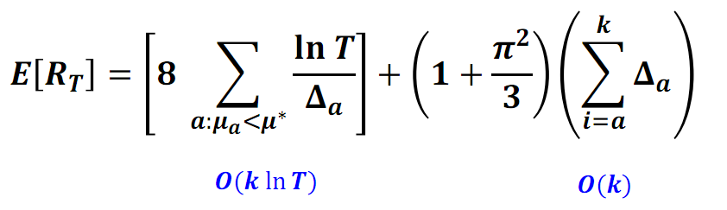

UCB1 Algorithm Performance
Theorem [Auer et al. 2002]
Suppose optimal mean payoff is
And for each arm let
Then it holds that
So, we get

Slide 35
What is news personalization?
Customize news feed based on users’ interests.
Particularly, Cold Start problem: How to personalize news for a new user?
Goal: Maximize user engagement

Slide 36
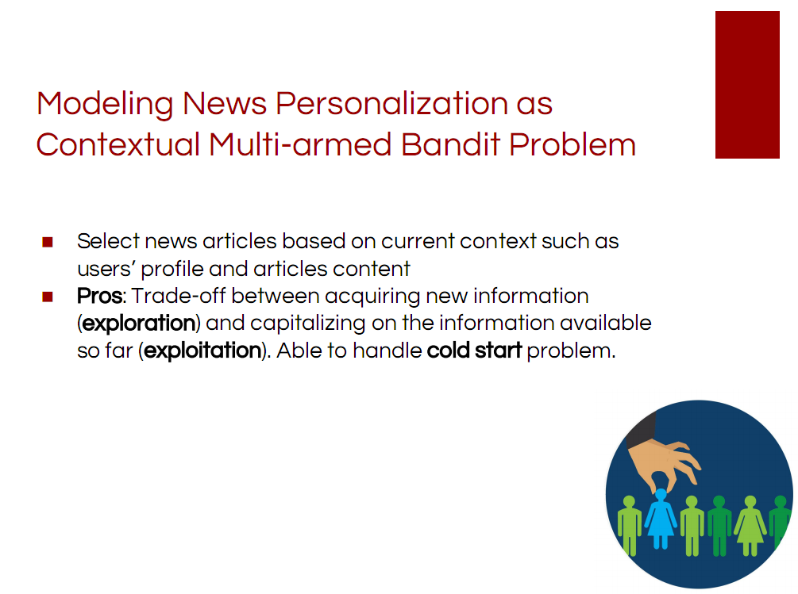

Slide 37
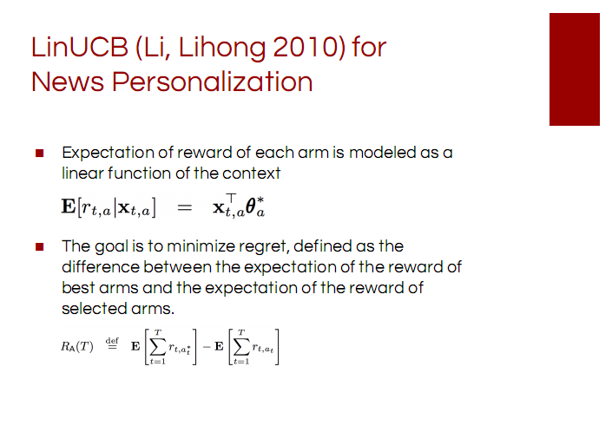

Slide 38
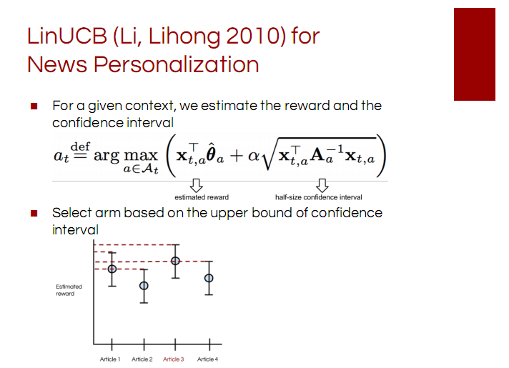

Slide 39
LinUCB: Discussion
LinUCB computational complexity is
Linear in the number of arms and
At most cubic in the number of features
LinUCB works well for a dynamic arm set(arms com and go)
For example, in news article recommendation, for instance, editors add/remove articles to/from a pool

Slide 40


Different between UCB1 and LinUCB
UCB1 directly estimates $μ_{a}$ through experimentation (without any knowledge about arm a)
LinUCB estimates $μ_{a}$ by regression
The hope is that we will be able to learn faster as we consider the context $x_{a}(user, ad)$ of arm a
${θ^{∗}}_{a}$ unknown coefficient vector we aim to learn

Slide 41

Empirical Results
Scenario
4.7m events(featured article, infos, click) in tuning set
36m events in test set
Articles and Users clustered into 5 categories

Slide 42
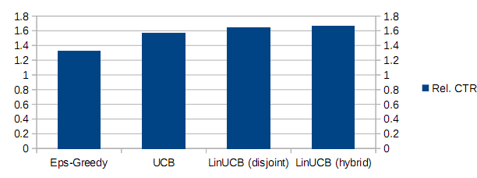
Empirical Results
Results

Slide 43


